Slide 1

RCB-IPL STRATEGY 2017
PRESENTED BY – THAILESH SINHA
sinhathailesh@gmail.com

Slide 2
ABOUT PROJECT
In this project I analyze data for Royal Challengers Bangalore (RCB), the goal was to identify top-performing, reliable players while optimizing investments in the mega player auction of 2017. The focus was on enhancing on-field performance and ensuring value for money by analyzing historical data and deriving actionable strategies.
This analytical approach enabled RCB to make data-backed decisions for building a competitive team, targeting both short-term match outcomes and long-term team stability.

Slide 3
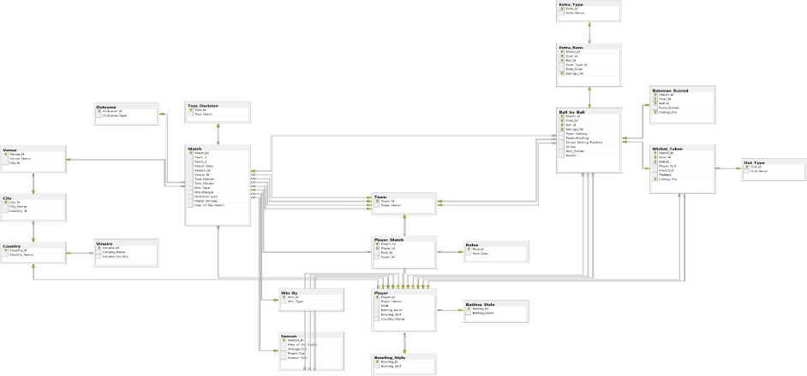
DATABASE SCHEMA

Slide 4
DATASET
ball_by_ball: Represents striker ID, non-striker ID, and bowler ID for each ball of each over in each match.
wickets_taken: Indicates which players got out and the type of dismissal.
batting_style: contain information about batting style of players.
bowling_style: contain information about bowling style of players.
city: it has information about which city venue is located.
country: in this table has country id , country name.
extra_runs: Details the extras conceded by each bowler.

Slide 5
DATASET
team: Lists each team ID and team names.
venue: Lists each venue ID and venue names.
season: Lists each season ID and the corresponding year.
player: Lists the player ID, player name, and the batting and bowling styles of each player.
extra_type: Lists the extra ID and extra names.
out_type: Lists the out type ID and out type name.
toss_decision: Lists the toss decision ID and toss decision names
outcome: it contain result of match.

Slide 6
DATASET
player_match: it has match information about player
rolee: it contain role description.
umpire: it has all umpire details.
win_by: it contain information about how a team win a match like by runs, by wickets etc.
matches: Contains information about the matches played, including the teams, venue, toss winner, toss decision, and the winning team of each match.

Slide 7
TOP RUN SCORER BATSMEN IN IPL
V Kohli leads with 2462 runs in 62 matches, showcasing remarkable consistency with a strike rate of 136.1.
DA Warner follows closely with 2336 runs in 61 matches and a higher strike rate of 143.93, making him a dynamic opener.
AB de Villiers stands out with an exceptional strike rate of 167.03, amassing 1955 runs in just 57 matches, making him a critical middle-order finisher.
RG Sharma (1891 runs in 64 matches) and SK Raina (1838 runs in 65 matches) have been consistent across all seasons with solid strike rates of 134.33 and 136.67, respectively.

Slide 8
TOP BOWLER IN IPL
DJ Bravo leads with 75 wickets in 49 matches across 3 seasons, highlighting his efficiency as a strike bowler with the best bowling strike rate of 14.19.
B Kumar has the second-highest wickets (74) in 61 matches across 4 seasons, indicating reliability in longer tournaments.
MM Sharma closely follows with 70 wickets and a better strike rate (18.41) than Kumar.
Harbhajan Singh and SP Narine have 65 and 61 wickets, respectively, showcasing spin effectiveness over 4 seasons.

Slide 9
TOP ALLROUNDER IN IPL
CH Gayle leads with the highest average runs of 32.94 and contributes 1.67 wickets on average, showcasing his dual impact as an all-rounder.
DR Smith (29.86 avg runs, 1.5 avg wickets) and KH Pandya (29.63 avg runs, 1.5 avg wickets) exhibit balanced performances, making them reliable options.
MP Stoinis stands out with 2.67 avg wickets, the highest among the players, along with an impressive 29.2 avg runs, highlighting his value as a bowler and a middle-order batsman.

Slide 10
TOP STRICKER BATSMAN IN IPL
AB de Villiers leads with the highest strike rate of 167.52, showcasing his ability to score quickly and dominate bowlers.
GJ Maxwell follows closely with a strike rate of 164.5, making him a lethal power-hitter, especially in high-pressure situations.
KA Pollard (148.92) and CH Gayle (144.24) demonstrate their ability to accelerate the scoring.
YK Pathan (144.15) and MS Dhoni (142.51) maintain strong strike rates, showcasing their finishing abilities in tight situations.

Slide 11
RCB BATTING ANAYSIS
The average runs scored during the powerplay remain consistent across all seasons, ranging between 42.88 and 46.19.
The middle overs (7–15) show consistent scoring, with averages between 52.5 and 57.75.
The middle overs (7–15) show consistent scoring, with averages between 52.5 and 57.75.
Season 9 shows the strongest death-over performance, complemented by improvements in the powerplay.

Slide 12
RCB WICKET TAKEN IN ALL POWER PLAY
The number of wickets taken in the powerplay remains relatively consistent across seasons, ranging between 1.53 (Season 8) and 1.75 (Season 6).
The middle overs consistently contribute to wickets, with values between 1.64 (Season 7) and 2.33 (Season 8).
The death overs show fluctuating performance, with the number of wickets taken peaking in Season 6 (3.06) but dropping to 2.56 in Season 9.
Season 6 is strong in both the powerplay and death overs, but middle overs underperform compared to other seasons.

Slide 13
RCB BOWLING ECONOMY
Season 6 and 7 displayed consistent economy rates (6.91 and 6.96), indicating disciplined bowling during the initial overs.
Season 7 had the best middle-over economy (6.6), reflecting tight bowling in the middle phase of the game.
Season 8 stood out with a remarkably low death-overs economy (5.86), showcasing excellent execution during the most challenging phase.
Seasons 6 and 8 were similar, with moderate economy rates (7.01 and 7.09).

Slide 14
RCB PERFORMANCE IN EACH VENUE
Wins: 15 matches, indicating a strong performance at their home ground.
Losses: 11 matches, suggesting occasional inconsistency even at home.
Draw/No Result: 2 matches, reflecting external factors like weather.
M. Chinnaswamy Stadium: Leverage home-ground advantage by strengthening strategies, especially in scenarios where they’ve faced losses.

Slide 15
RECOMMENDATION
Focus on Multi-skilled Players:
Prioritize players who contribute both with bat and ball, as they add depth to the team and offer flexibility in squad balance. Visualizations, such as a scatter plot comparing players’ batting and bowling performances (e.g., runs scored vs. wickets taken), can highlight versatile players.
Prioritize Power Hitters for Middle Overs:
RCB has traditionally relied heavily on top-order performance. They should target reliable power hitters for the middle order who can maintain a strong strike rate under pressure. A bar chart showing potential players' strike rates and average scores in overs 10-15 could help identify impactful players for this role.
Strengthen Death Bowling:
Death bowling has been a weak spot for RCB in past seasons. They should aim to secure bowlers with high death-over wicket-taking ability and economical performance in the last 5 overs.

Slide 16
RECOMMENDATION
Seek Players with Proven Performance at Home Venues:
Players who perform well in the Chinnaswamy Stadium’s conditions (high-scoring pitch, smaller boundaries) will be an asset. Filtering players based on past performance at this venue and visualizing their averages and strike rates at similar high-scoring venues could help pinpoint ideal candidates.
Consider Players with Strong Morale-boosting Presence:
Team dynamics are crucial for RCB's consistent performance. Identifying players whose presence has positively influenced past teams’ win percentages can improve team morale. Win percentage charts of players with their respective teams over multiple seasons would be beneficial for selecting such players.

Slide 17
RECOMMENDATION
Balance Experience with Emerging Talent:
RCB could invest in emerging players with high potential while retaining a core of experienced players. A radar chart displaying experience factors (matches played, years of experience) alongside key performance metrics (average, economy, strike rate) could help achieve this balance.
These data-backed strategies would support RCB in creating a well-rounded, resilient team structure in the auction.

Slide 18
CONCLUSION
RCB’s persistent struggles to win the IPL trophy can largely be attributed to key issues such as inconsistency in batting and bowling performances, a lack of depth in their squad, and an over-reliance on a few star players like Virat Kohli, AB de Villiers, and Chris Gayle in critical matches. While their home-ground performance at M. Chinnaswamy Stadium has been relatively strong, occasional inconsistencies even at home highlight the need for better strategies tailored to their familiar conditions.
One of the major areas for improvement lies in their death-over bowling, which has often proved costly in tight matches. Strengthening the bowling attack, particularly during the final overs, will reduce the opposition's ability to capitalize on critical moments. Similarly, RCB’s middle-order batting has shown vulnerabilities under pressure, often failing to provide the required stability in chasing or setting competitive targets. Addressing this with dependable middle-order options will ensure a more balanced batting lineup.

Slide 19
THANKING
YOU

